Slide 1

RTDS-RSCAD Logic Bomb: A Proof of Concept
By: Daniele Ricciardelli

Slide 2

Table of Contents
Introduction
What is Cybersecurity
Attack & Defend environments related to ECE
How this project started
Previous Projects – Real-Time file disruption (Local)
Initial Idea – Attack / Test defense mechanism implemented in the RTDS
Human vulnerability found – Creation of the project
Understanding the RTDS & RSCAD
Possible human vulnerability and the exploitation of this one
Script development
Understanding the code
Launching the code
Tips to keep in mind
New horizons for future development

Slide 3

Objective
This manual serves as a comprehensive guide for those new to cybersecurity who wish to grasp its foundational concepts, explore its relevance in Electrical and Computer Engineering (ECE) contexts, and build upon the work presented in this project. It begins with the essential knowledge I had to acquire before diving into this field, outlines my process of identifying vulnerabilities through reconnaissance, and provides a detailed walkthrough of the custom script I developed, explaining both its creation and functionality.

Slide 4

Introduction
In an increasingly interconnected world, cybersecurity has become a fundamental concern—not only for governments and corporations, but also for engineers and developers working in critical infrastructure domains. As smart grid systems, real-time simulations, and embedded electronics become integral to modern Electrical and Computer Engineering (ECE), the need to understand, test, and secure these systems has never been more urgent.
This project emerges at the intersection of academic exploration and hands-on vulnerability assessment. Initially inspired by simple experiments in real-time file disruption, the work evolved into the development of a stealthy script capable of modifying sensitive simulation data within an RTDS (Real-Time Digital Simulator) environment. While harmless in its intent, this logic bomb script serves as a proof of concept – highlighting just how susceptible human error and weak system monitoring can render even sophisticated setups vulnerable.
What started as a learning exercise quickly revealed an important truth: human factors often remain the weakest link in cybersecurity. Through this project, I not only deepened my understanding of system security in ECE applications but also contributed to the dialogue on how such vulnerabilities can be responsibly identified and addressed.
This manual was created to document that journey; from the foundational knowledge required to enter the field, to the process of reconnaissance and discovery, to the technical implementation and operation of the script. It is meant to educate, to provoke thought, and most importantly, to empower others to explore cybersecurity in a responsible, ethical, and technically rigorous way.

Slide 5

What is Cybersecurity?
Cybersecurity is the practice of protecting systems, networks, programs, and data from digital attacks, damage, or unauthorized access. These attacks are often aimed at accessing, changing, or destroying sensitive information, disrupting normal operations, or extorting money from users or organizations. As our reliance on digital technologies grows, especially in critical infrastructure like power grids and embedded control systems, the importance of cybersecurity becomes not just technical, but foundational to public safety and trust.
At its core, cybersecurity is built upon the CIA triad, a model that outlines three fundamental principles:
Confidentiality – Ensuring that sensitive information is accessed only by authorized individuals. This involves encryption, access control, and authentication measures to prevent data leakage or spying.
Integrity – Maintaining the accuracy and completeness of data over its entire lifecycle. This ensures that data has not been altered or tampered with, either maliciously or accidentally, and often involves checksums, hashing, and digital signatures.
Availability – Guaranteeing that authorized users have timely and reliable access to information and systems. This principle is threatened by denial-of-service (DoS) attacks, power outages, or system failures—and often requires redundancy, backups, and proper system monitoring.
These three pillars Confidentiality, Integrity, and Availability form the backbone of all cybersecurity strategies. Any threat or vulnerability can typically be understood in terms of which part of this triad it undermines.

Slide 6

Attack & Defend Environments Related to ECE
In Electrical and Computer Engineering (ECE), the integration of physical systems with digital technologies has created incredible opportunities, but it has also introduced serious cybersecurity risks. Systems such as SCADA, RTDS simulations, embedded platforms, and smart grids are increasingly dependent on software, which makes them attractive targets for cyber attackers. To build resilient systems, engineers must understand both the offensive and defensive sides of cybersecurity.

Slide 7

The Attacker Perspective: Exploiting ECE Systems
Adversaries who target ECE-related infrastructure often seek to disrupt operations, steal sensitive data, or compromise the integrity of critical systems. Their strategies include:
File Disruption and Tampering Attackers can create malicious scripts that alter or corrupt simulation files such as .dtp files in RTDS. This may lead to simulation failures, inaccurate results, or unnoticed sabotage that affects long-term outcomes.
Unauthorized Access to Sensitive Information Weak authentication mechanisms or unsecured communication channels can allow attackers to access control system data, configuration files, or even gain full access to critical components.
Infrastructure Disruption Cyber attackers may aim to disable or degrade control systems. This could involve injecting false data into a simulation, delaying control signals, or halting a process altogether. In power systems, this can translate into outages or safety hazards.

Slide 8

The Defender Perspective: Awareness and Vigilance
The best defense begins with knowledge and consistent best practices. Those working with ECE systems must stay informed and take action to reduce risks. Important defensive approaches include:
Education and Security Awareness Understanding how attackers operate is critical. Engineers should recognize unusual system behavior, understand attack vectors, and be familiar with the risks tied to their specific tools and platforms.
Safe Software Practices Only download software or packages from trusted sources. Avoid running executables or scripts unless their origin is verified. Using package managers and checking digital signatures can help prevent unintentional malware installation.
Process and System Monitoring Regularly review active processes, background services, and system startup programs. Malicious scripts can hide quietly and execute only under certain conditions. Early detection is key.
Routine Audits and Logs Review Check simulation logs, audit trails, and system outputs for anomalies. Look for unexplained file modifications, irregular timestamps, or processes that do not match expected behavior.

Slide 9

Previous projects
Before developing this current project, I studied and analyzed several earlier efforts in the realm of smart grid cybersecurity. One notable example was the Smart Grid Cyber Test Bed Development, a comprehensive academic initiative that simulated a smart grid environment using RTDS and leveraged tools like OpenPDC, SQL servers, and virtual machines to test cyber vulnerabilities.
This project was incredibly valuable. It demonstrated how attackers could exploit unsecured SQL ports, extract PMU data, and manipulate critical infrastructure settings using Metasploit modules. From a learning and proof-of-concept perspective, it was highly effective and offered a concrete look at real-world threats, bridging theory and practice in an academic setting.
However, while the project had a strong conceptual foundation and valuable technical depth, it still falls short as a complete representation of real-world threats that entities like Southern California Edison (SCE) or other critical infrastructure providers face. One of its key limitations is its dependency on a wired connection to both the RTDS and the operational machine. This introduces a level of physical access that is often unrealistic in external attacks. In real-world cyber threats, attackers frequently operate remotely, without ever needing to physically access the system they are targeting.
Additionally, the environment used in the testbed was tightly controlled. The devices, IP configurations, and services were all manually assigned and operated in an isolated virtual network. This is excellent for teaching and understanding system behavior, but it limits the unpredictability and complexity often present in actual deployment environments where threats arise in more dynamic and less secure settings.
In summary, while previous projects like the RTDS-based testbed provide an excellent foundation and show how attacks could theoretically unfold, they highlight the need for more stealthy, autonomous, and realistic threat models. This gap is where my current work fits in—by exploring how subtle, low-visibility logic bombs can persist and operate with minimal system oversight, this project seeks to simulate vulnerabilities that are more likely to occur due to human error, misconfigurations, or insufficient monitoring, without requiring deep system integration or physical access.

Slide 10
Initial Idea – Attack / Test Defense Mechanism Implemented
Attack | Tools Used | Impact
Flipper Zero Wireless Exploit | Flipper Zero | Jamming, Command Injection, Replay
Satellite Time-Stamp Spoofing | GPS Spoofer | False Data, Timing Errors, Instability
Insider Badge and Credential Theft | Flipper Zero, Social Engineering | Unauthorized Access, Configuration Changes
SQL Injection on OpenPDC | SQL Queries, Injection Tools | Data Corruption, Control Failures
Multi-Layer Coordinated Attack | Flipper Zero, DoS, GPS Spoofer | System Overload, Misleading Data
At the beginning of this project, I aimed to explore and simulate a series of realistic cyber-attacks that could potentially compromise ECE systems integrated with RTDS environments. Drawing inspiration from known vulnerabilities and recent trends in hardware exploitation and data injection, I focused on testing the feasibility of attacks like those shown in the chart above.
Some of the initial attack concepts included:
Flipper Zero Wireless Exploits, targeting command injection and jamming of wireless communications.
Satellite Time-Stamp Spoofing, which could destabilize time-sensitive simulations by introducing corrupted time data.
Credential Theft and Badge Cloning, using social engineering and low-cost tools to mimic insider access.
SQL Injection on OpenPDC, aimed at manipulating control system data, potentially causing misconfigurations or corrupting PMU streams.
Multi-Layer Coordinated Attacks, where multiple vulnerabilities are exploited simultaneously to create confusion, overload systems, and mislead monitoring processes.

Slide 11
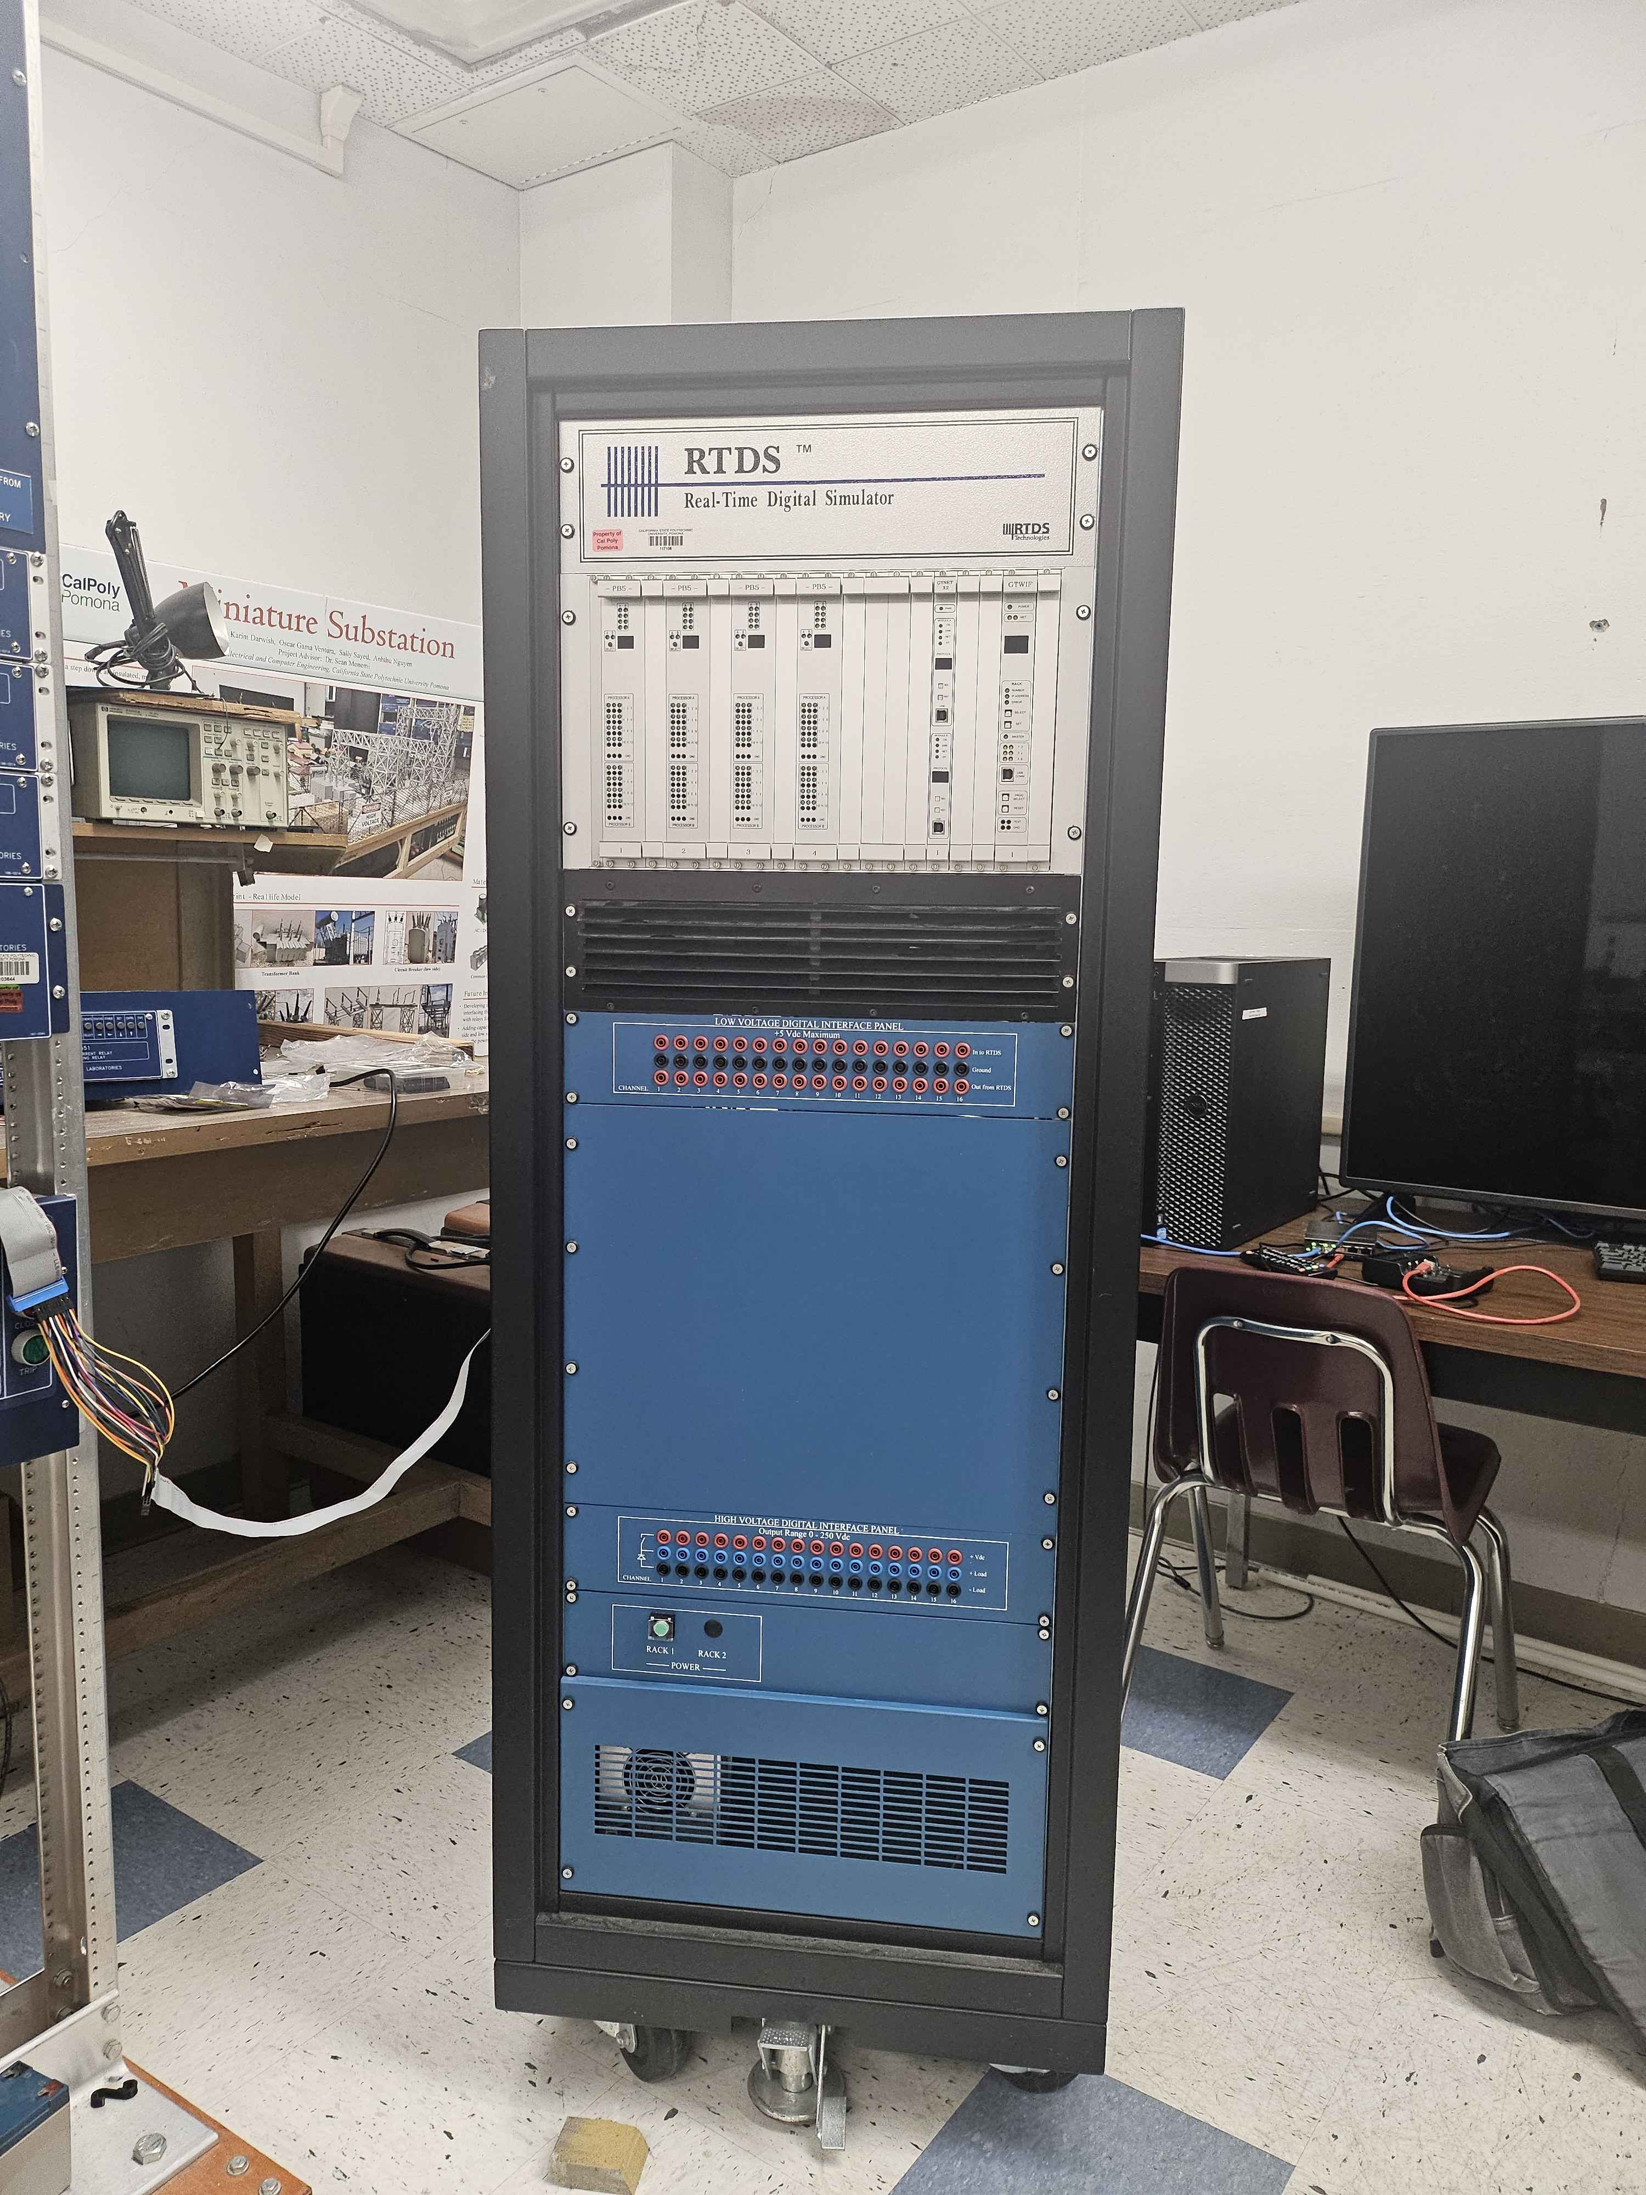
RTDS Defense Mechanisms
One of the main limitations lies in the dependence on physical connectivity. Many of these attack simulations require direct, wired access to both the RTDS machine and the host system, which in real-life is a major security barrier. Organizations like SCE operate on tightly segmented networks with strict physical and logical access controls. This means that even a highly sophisticated attack would face multiple layers of isolation, reducing the realism of many lab-based simulations.
To better understand how such a high-value system defends itself, I explored the built-in security features of the RTDS platform and its integrated testbed, which includes a robust combination of prevention, detection, and recovery mechanisms:
1. Intrusion Detection Systems (IDS): RTDS uses both anomaly-based and signature-based detection. These mechanisms identify unusual behavior and known threat patterns, allowing for early detection of potential intrusions before they cause harm.
2. Network Security Configurations: The entire RTDS environment operates on an isolated, offline network, drastically reducing its exposure. Virtual machines with network segmentation further reduce the lateral movement of an attacker inside the system.
3. Encrypted Communication and Access Control: Secure Shell (SSH), strict Telnet IP restrictions, and in some cases VPNs are used to limit access to RTDS components. Only whitelisted devices can communicate with the system.
4. Time Synchronization Defenses: Using SNTP and dedicated GTSYNC cards, the system resists time spoofing attacks by verifying precise synchronization, thereby protecting the validity of time-sensitive measurements and operations.
5. Cyber-Physical Test Bed: RTDS integrates simulation tools and network analyzers that allow for controlled attack experiments, helping researchers simulate attacks like DoS, spoofing, and bad data injection safely.
6. Data Integrity Mechanisms: Systems such as OpenPDC and the SQL database are equipped with bad data detection logic. If corrupted or injected data is detected, it is flagged and isolated from decision-making processes.
7. Failover and Recovery Protocols: Redundancy is built into both the communication lines and the power delivery system. In the event of an attack or failure, the RTDS machine can trigger microgrid reconfigurations and fallback routines.
8. Access Authentication: Password protection is enhanced with optional multi-factor authentication (MFA) and role-based access control (RBAC). This ensures that users only have access to parts of the system relevant to their role, reducing insider threat risk.
9. Incident Response Capabilities: Real-time monitoring through OpenPDC, log preservation, and automated emergency procedures ensure that even when an attack occurs, the system can isolate threats, recover operations, and support post-attack forensics.

Slide 12
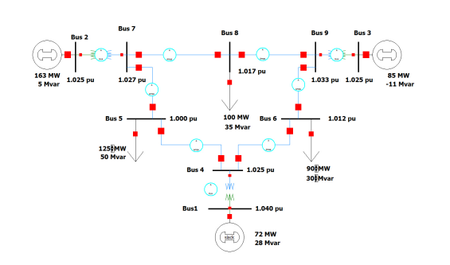
Human vulnerability found – Creation of the project
While working with the RTDS environment and using the RSCAD software, I came to a critical realization that shaped the direction of this project. In order to execute any simulation in RSCAD, a file with the extension .dtp is required. This file is not just another data file. It serves as the compiled version of the entire project and contains everything from control logic and simulation parameters to the system's runtime configuration.
The .dtp file is essentially the key to executing a power simulation. If this file is altered or corrupted, the simulation results will be affected, possibly without any indication that something has gone wrong. What concerned me most was not the structure of the file itself, but how casually it is handled in most workflows.
In most environments, users simply generate the .dtp file, move it between machines, or run it directly without verifying its integrity. There is rarely any use of hash checking, no digital signatures, and no automated file integrity monitoring. Most users trust that the file is valid simply because it was produced by themselves or someone on their team.

Slide 13

This behavior presents a major vulnerability. It is not a failure of the system, but a consequence of human assumptions. By not checking for file tampering, users leave themselves exposed to subtle but impactful attacks. A modified .dtp file that still looks and behaves normally during loading can introduce altered parameters, corrupted logic, or even malicious configurations without drawing attention.
This discovery was the origin of my logic bomb concept. I wanted to demonstrate how a script could be developed to detect and target these .dtp files, apply a small change that modifies behavior, and then leave the file in place without raising suspicion. Since most users do not examine the file in detail, the attack could succeed without ever being noticed.
What this reveals is a broader truth. Security risks do not always come from external hackers or complex exploits. Sometimes, the biggest risks are the habits and assumptions of the people working inside the system. This project was created to bring attention to that kind of human vulnerability and to demonstrate how easily it can be turned into a technical weakness.

Slide 14

Script Development Understanding the code

Slide 15
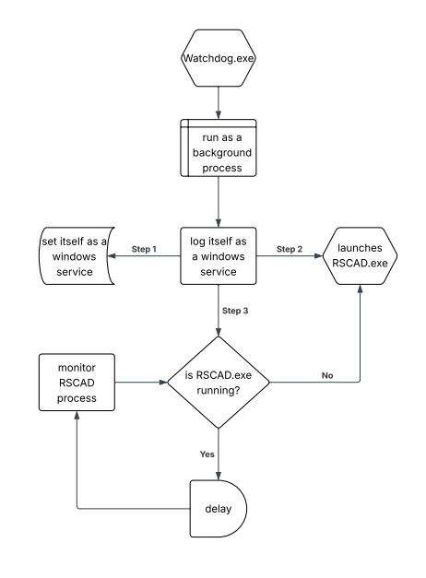
The watchdog
The first part of the system is a background application that installs and runs itself as a Windows service. Its main purpose is to ensure persistence and stealth. Once installed, this application runs silently in the background without requiring user interaction or displaying a user interface. It is configured to automatically start with the system, blending in with legitimate services that users rarely monitor.
This component acts as a watchdog, continuously monitoring specific directories or conditions. It remains active across reboots, which allows it to persist in environments where users may shut down or restart the system regularly. The service also checks for the presence of .dtp files in designated folders and triggers the logic bomb component only when certain criteria are met.
By running as a service, this part of the code is difficult to notice for someone who does not actively audit background processes or check the registry keys responsible for service configuration. Its design highlights the risk of overlooked services in operational environments.

Slide 16
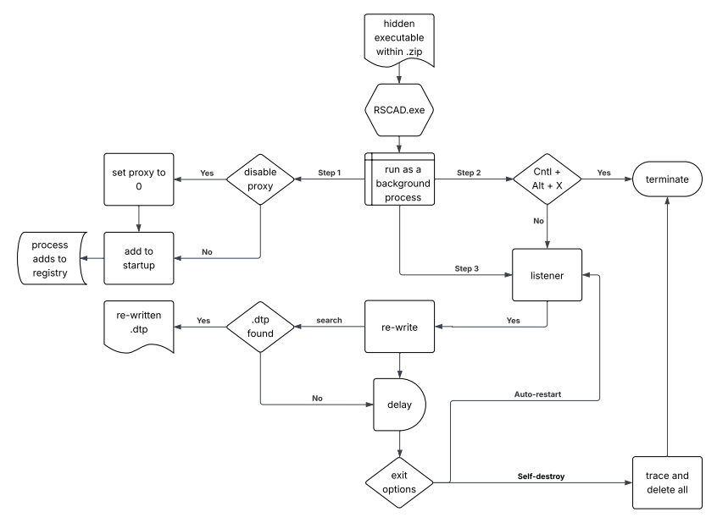
The logic bomb
The second part is the actual logic bomb. This is the payload that modifies the .dtp files. It is activated only under specific conditions determined by the watchdog. Once triggered, it locates the most recent or most relevant .dtp file and alters key parameters within it. For example, the script can target the base voltage (VBASE) value, changing it in a way that may compromise simulation accuracy or introduce instability without crashing the system.
The logic bomb is built to be subtle. It does not delete or corrupt the file in an obvious way. Instead, it makes minor changes that are difficult to detect unless the user is comparing outputs closely or inspecting the file contents directly. This reflects a realistic scenario where human oversight and trust in the workflow can allow a modified file to slip through undetected.

Slide 17
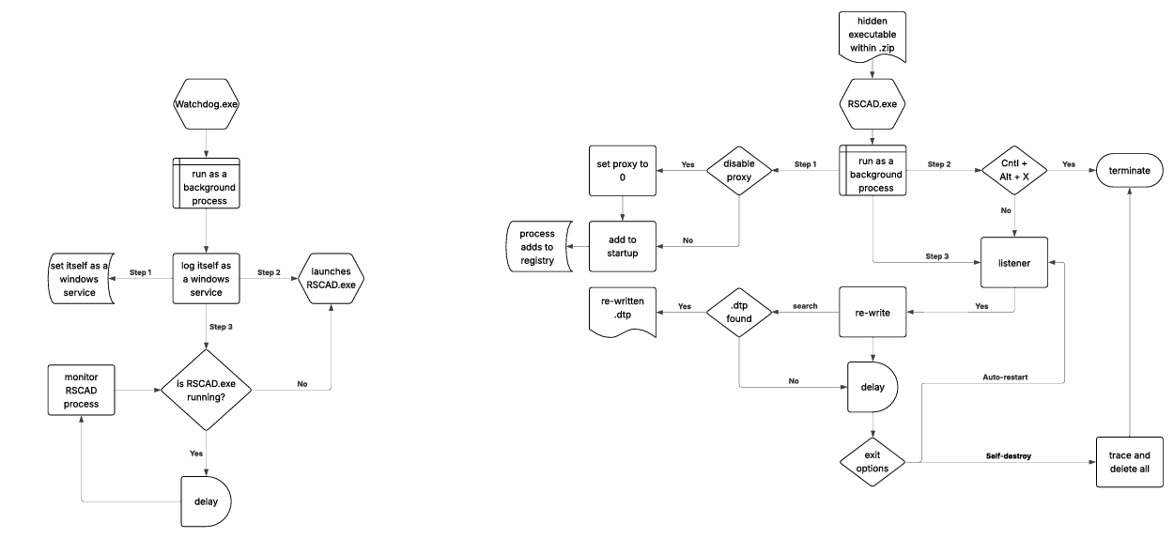
Together, these two components demonstrate how an attack can be both persistent and discreet. The watchdog ensures long-term presence and triggers the payload under controlled conditions, while the logic bomb carries out the core disruption quietly and effectively.

Slide 18
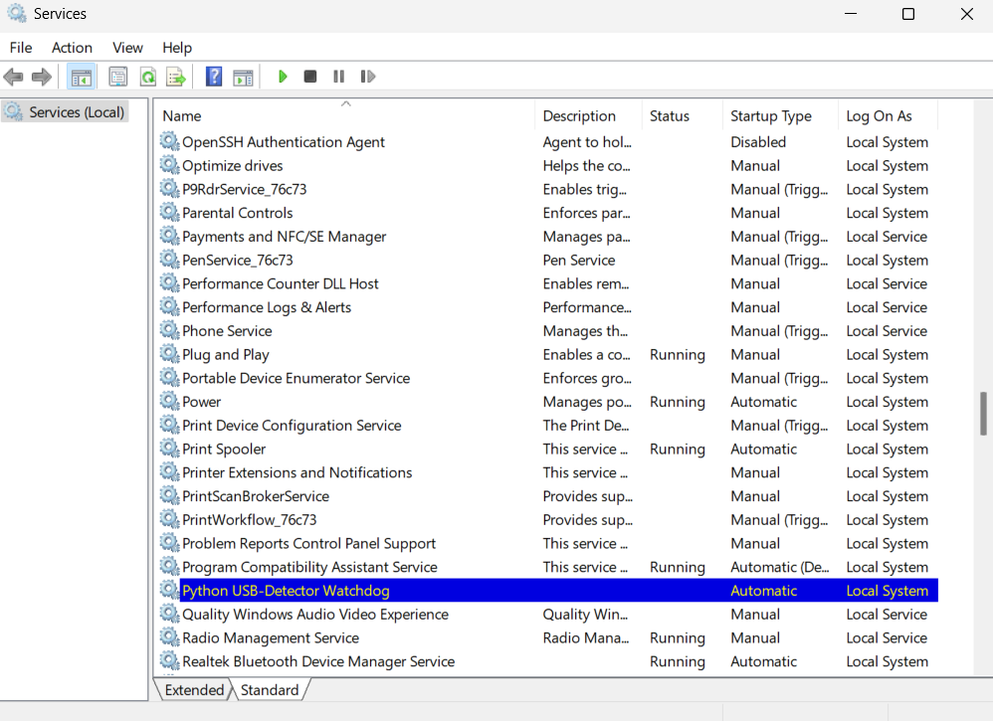
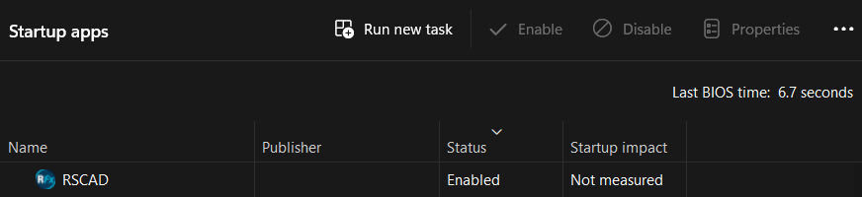
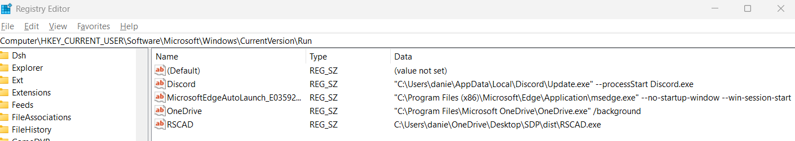
Launching the code

Slide 19
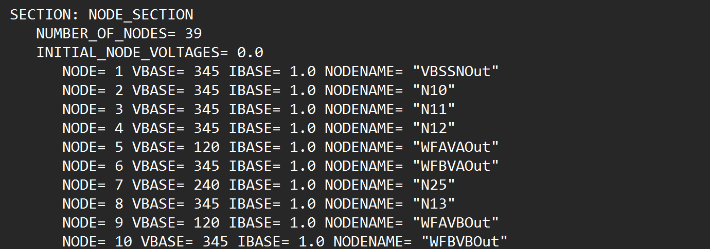
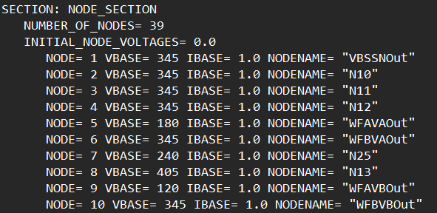
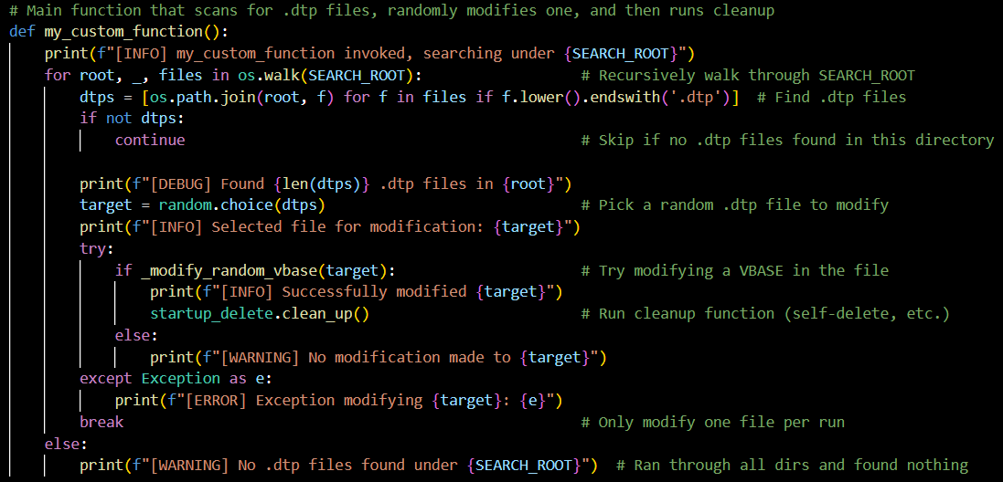
Launching the code

Slide 20
Tips to keep in mind
1. Hardcoded Directories Should Be Adapted In the current version of the script, I used specific directories where I knew the .dtp files would be located. This made the script efficient for my environment but may not apply universally. To generalize the logic bomb, consider implementing a recursive file search that scans commonly used simulation or export folders throughout the system. This makes the payload more adaptable and reduces dependence on static paths.
2. Windows Defender May Flag the Script Because the script behaves like a background service and modifies files silently, it can trigger antivirus software such as Windows Defender. To avoid interruption during demonstrations or testing, it is recommended to configure Defender to exclude the script’s directory from real-time protection. This allows the logic bomb and service components to run smoothly without being quarantined or blocked mid-execution.
3. Service Registration Requires Admin Privileges Installing the watchdog component as a Windows service requires administrative rights. Be sure to run any installer script or setup process with elevated permissions. Without this, the service will fail to register or execute properly on boot.
4. Be Aware of File Locking Issues If the .dtp file is being accessed by another process (for example, RSCAD is open), the script might encounter a file lock or read/write error. To avoid this, ensure the file is not being used when the script attempts to modify it. Implementing error handling for these cases is also advised for more robust behavior.
5. Consider Adding Logging (For Demonstration Purposes) To better visualize what the script is doing during a live presentation, you may temporarily add a logging function. This can output a log file showing when a .dtp file was detected, which parameters were modified, and whether the logic bomb executed. This is especially useful for educational environments where transparency is required.
6. Use File Hashes to Demonstrate the Tampering Although the goal is to remain stealthy, for demonstration purposes it is helpful to calculate and display the file hash (e.g., SHA-256) before and after the attack. This proves that a change occurred even if the content difference is not obvious to the naked eye.
7. Test on an Isolated Environment Always perform tests in a virtual machine or isolated lab environment. Since the code is designed to modify simulation files and run as a background process, it is best to avoid unintended disruptions to your host system.
8. Modify the Trigger Conditions Based on Use Case Currently, the logic bomb may be triggered based on conditions such as time, file detection, or system idle state. These conditions can be adjusted depending on how you want to simulate a stealth attack. For example, triggering only if a new .dtp file appears or if a specific user logs in

Slide 21
New horizons for future development
1. Enhanced Evasion from Antivirus Detection Currently, the script may trigger Windows Defender due to its behavior and access patterns. A future version could integrate advanced evasion techniques such as code obfuscation, dynamic loading of modules, or process hollowing. This would allow the script to operate without requiring manual whitelist configurations and would simulate a more realistic adversarial model.
2. Automated RSCAD Setup with Payload Installation To make the logic bomb even more effective in unfamiliar environments, the script could include a function to download and silently install all necessary components, including the RSCAD software, libraries, and dependencies. This would enable the payload to operate in new or freshly created systems without requiring prior setup.
3. Remote Delivery and Execution One powerful enhancement would be the ability to send and execute the script remotely. This could involve attaching the logic bomb to an email, embedding it in a macro-enabled document, or hosting it on a compromised website. Once downloaded and executed, the script could automatically install itself, register as a service, and begin monitoring for .dtp files.
4. SSH Integration for Remote Control A future version of the script could include an SSH client that allows the attacker to connect back to the infected machine once certain conditions are met. This could provide a way to remotely browse directories, issue commands, or even modify new .dtp files in real time without needing physical access to the machine.

Slide 22
New horizons for future development
5. Time-Based or Behavioral Triggers Adding more complex triggering conditions would improve stealth and flexibility. For example, the logic bomb could activate only at specific times of day, after a certain number of reboots, or only if the machine detects that RSCAD is open. These behavioral triggers make the attack harder to trace and easier to control.
6. Integration with Network Discovery Tools In a more advanced version, the script could scan the local network to detect other machines running RTDS-related services. It could then propagate itself or identify targets where .dtp files are stored, expanding the attack scope beyond the initially infected system.
7. Command-and-Control Framework For high-level control, a command-and-control (C2) interface could be implemented. This would allow real-time monitoring and remote command execution from a centralized dashboard, simulating the tactics used in targeted persistent threats.
8. Embedded Reporting or Exfiltration The modified .dtp data or environmental logs could be exfiltrated silently to a remote server. This would allow the attacker to collect valuable information about how the file was used or whether the simulation results were affected.

